Slide 1

Tom Wanous - Alec Waters - Elsa Freudenthal
Folly Quevi - Nawaf Alharbi

Slide 2






Our Company

Slide 3
The Problem
No inventory system to track products in-store
Lead to over-ordering of more product
Lose track of what products are carried
Stolen items are harder to track
ROI on products cannot be calculated easily

Slide 4
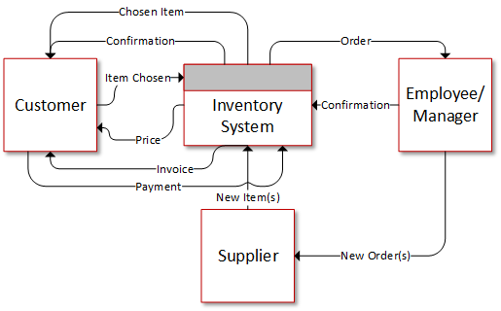

Slide 5
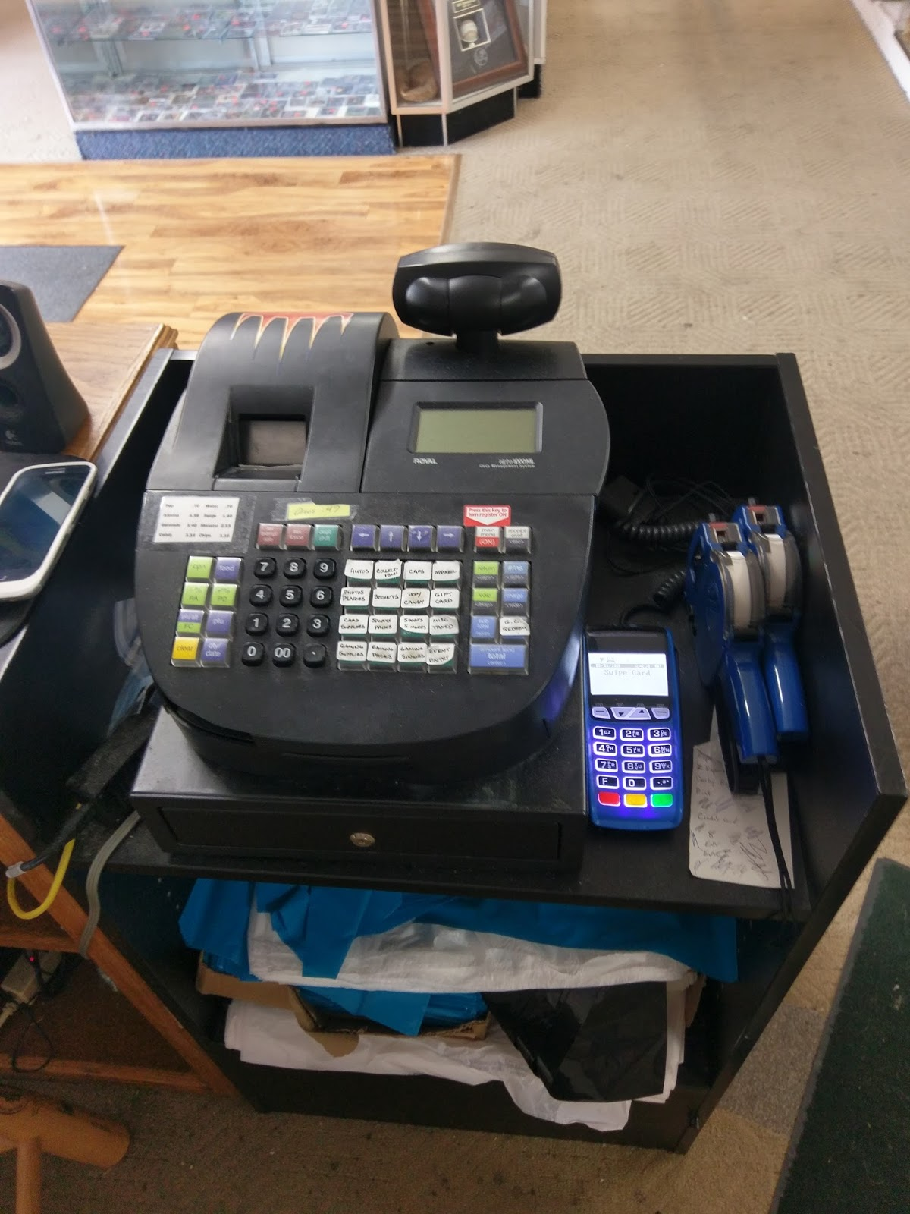

Slide 6
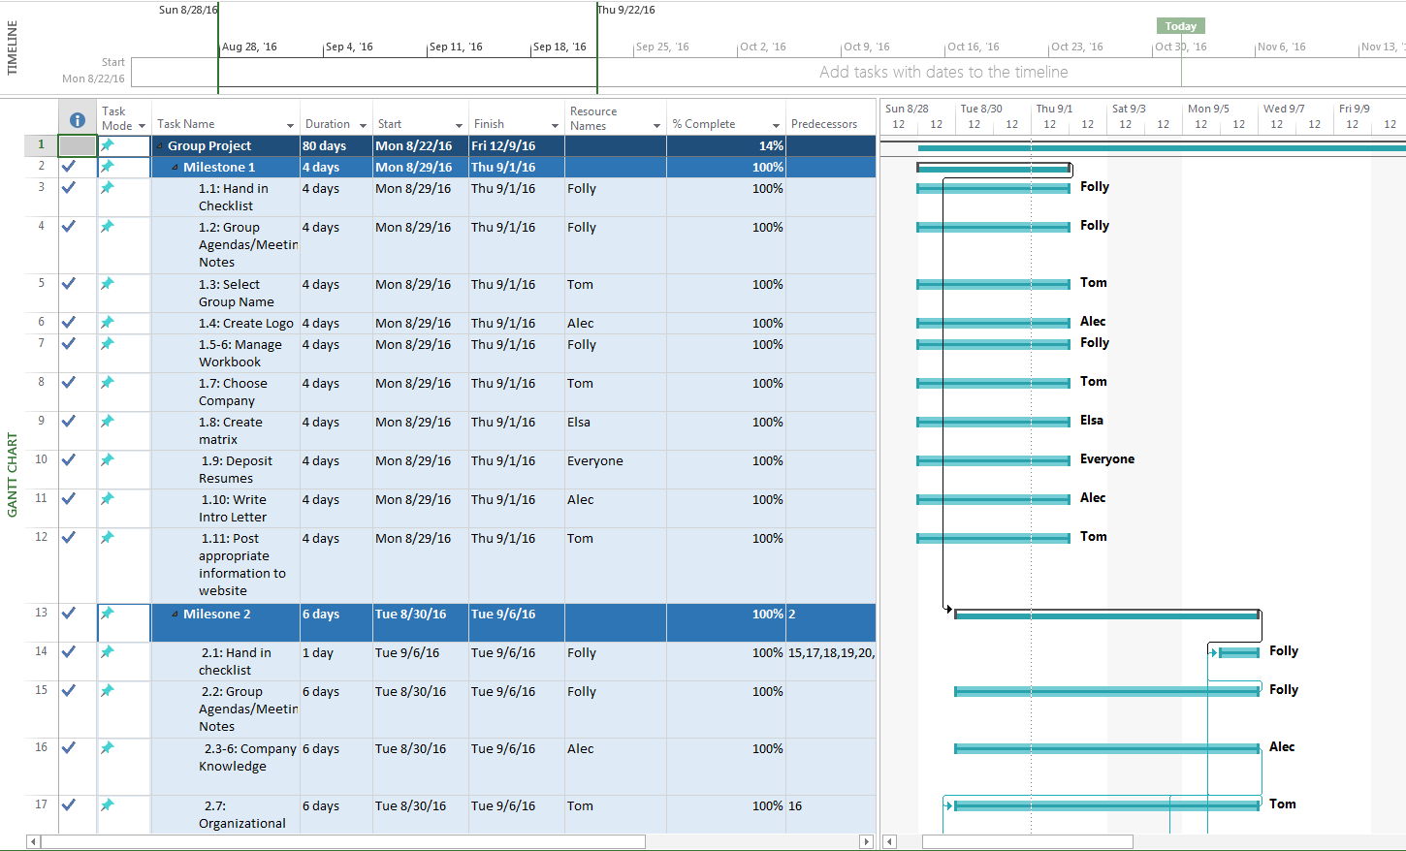
Project Plan

Slide 7
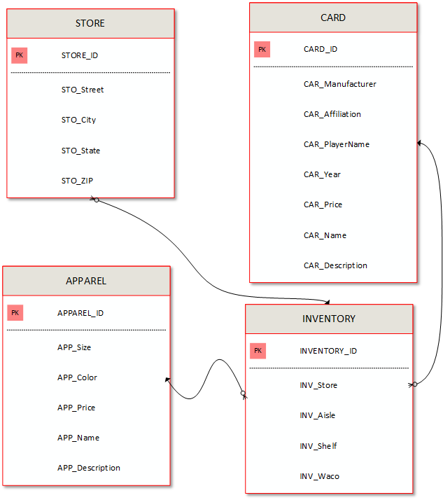

Slide 8
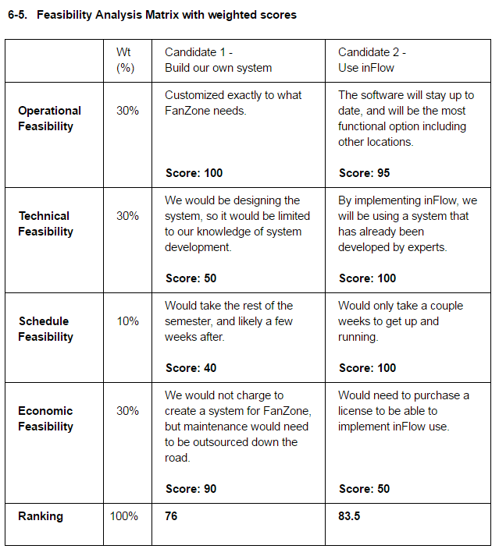

Slide 9


Slide 10
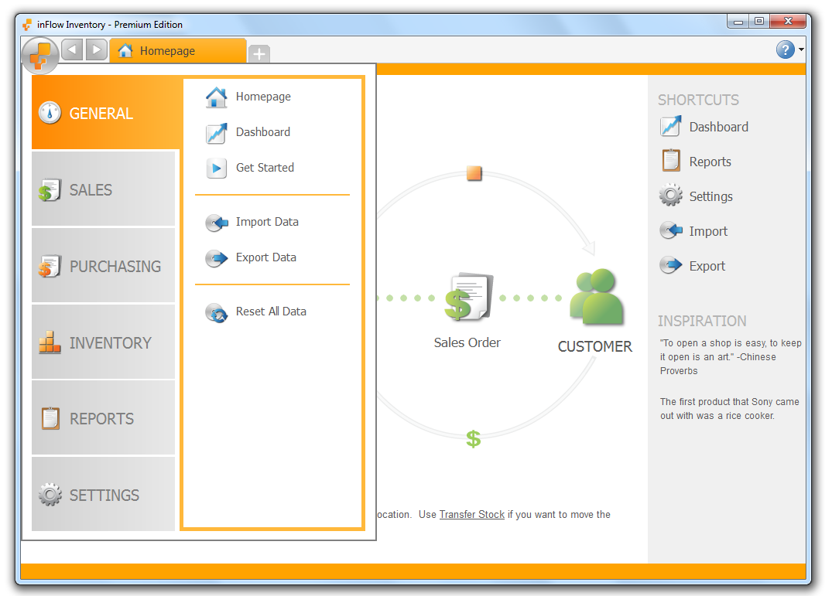

Slide 11
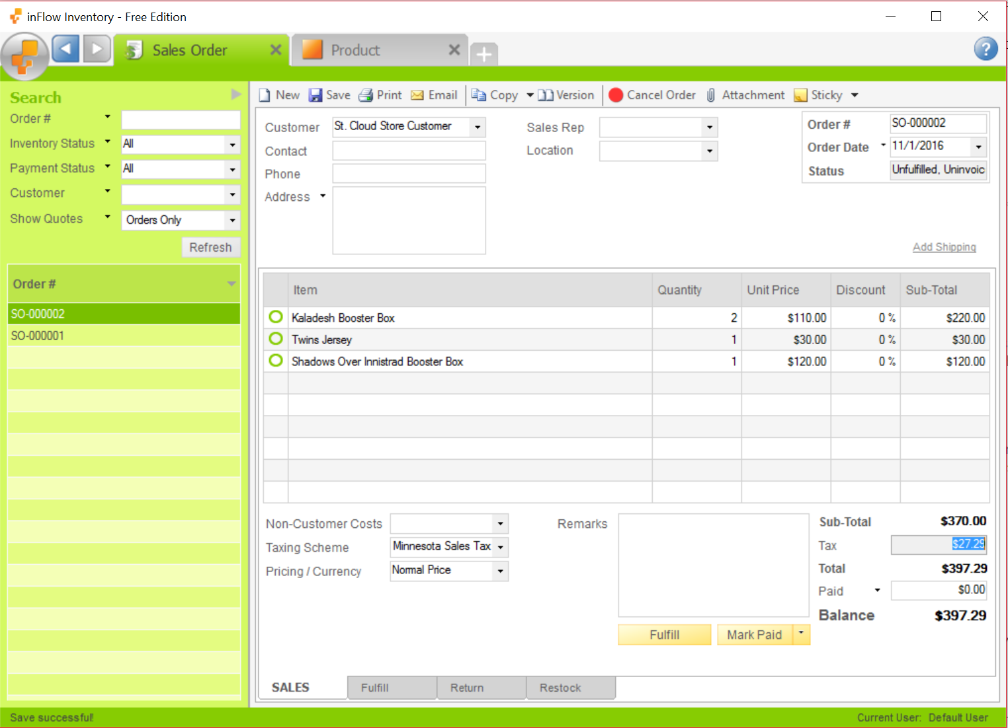

Slide 12
Summary
The Fan Zone
The Problem
The Solution

